Slide 1
The Lais of Marie de France
Contexts & Questions

Slide 2
Initial Questions
The Literary Context: What is a “Lai” ?
The Author: Who was “Marie de France” ?
The Historical Context: When were they written, where, for what audience ?
The Manuscript Context: How did the Lais come down to us today ?

Slide 3
The titles of all the Lais
Guigemar
Equitan
Le Fresne (The Ash Tree)
Bisclavret (The Werewolf)
Lanval
Les Deux Amants (The Two Lovers)
Yonec
Laüstic (The Nightingale)
Milun
Chaitivel (The Unhappy One)
Chevrefoil (The Honeysuckle)
Eliduc
These are in the order they appear in London, British Library, Harley 978.
The lais are almost all named for their main character.
Where there is no translation, the title is the proper name of the main character.
N.b. Links are to Wikipedia (whose entries for the lais are pretty good!)

Slide 4
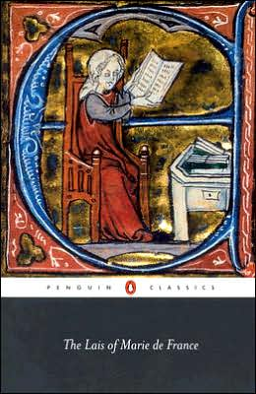
What is a “lai” ?
And how do we know ? Where do we find this information ?

Slide 5
How/Where do we find out what a “lai” is ?
We google it ! Duh.
Yeah, but how/where did Google get its definition ?
Where would you look ? How would you go about finding the answer ?
Where do scholars of medieval literature look ? What medieval sources are there to answer such questions ?

Slide 6
“The” Manuscript
British Library, Harley 978
Folio 118r
Beginning of the Prologue
Digitised manuscript (http://www.bl.uk/manuscripts/Viewer.aspx?ref=harley_ms_978_f118r)
What information does it give us about the text ?
Nothing !

Slide 7
Indications in the text itself
Prologue to the Lais
Prologues to individual lais
Des lais pensai qu’oïz aveie.
…
Rime en ai e fait ditié,
soventes feiz en ai veillié.
So I thought of lays which I had heard … I have put them into verse, made poems from them and worked on them late into the night.
Yonec: Now that I have begun to compose lays, I shall not cease my effort but shall relate fully in rhyme the adventures that I know.
Puis que des lais ai comencié
ja n’iert pur nul travail laissié;
les aventures que j’en sai,
tut par rime les cunterai.

Slide 8
What is a “lai” ?
From what Marie says in the Lais themselves:
  Song composed about an “adventure” by the Bretons
  Verse narrative written by Marie (based on the song)
The word “lai” is derived from the Celtic word for song
From observation of the texts:
  Form of verse: Octosyllabic rhyming couplets
  Subject: Love, broadly speaking
  Style: short stories, “courtly” (i.e. about kings, nobles, knights and ladies), often some magical element(s) but not always

Slide 9
Initial Questions
The Literary Context: What is a “Lai”?
The Author: Who was “Marie de France”?
The Historical Context: When were they written, where, for what audience?
The Manuscript Context: Where are the Lais preserved?

Slide 10
Who was the author of the Lais ?
A detective story
Where do we find her name and why is she called “Marie of France”?
  Prologue to the Lai of Guigemar: “Hear my lords, the words of Marie” (Oyez, seigneurs, que dit Marie, l.3)
  Three other texts in Old French whose author names herself Marie:
    Epilogue of the Espurgatoire seint Patriz (Purgatory of St Patrick)
    Epilogue of the Ysopet (Animal fables): “My name is Marie, I am from France” (Marie ai num, si sui de France)
    Epilogue of the Vie seinte Audree (Life of Sainte Audrey)
  One reference outside of her own works: in the prologue of the Life of Saint Edmund the King (by Denis Piramus, c. 1180): “Dame Marie ... composed lais in verse … for which she was greatly praised...”

Slide 11
The English Connection
All four texts are in Old French with both continental and English traits.
British Library, Harley 978 is an English manuscript, and contains both the Lais and the Fables.
All four works with Marie’s name have “English” origins:
  The Espurgatoire is a translation/adaptation of a Latin text written by an English Cistercian monk.
  The Ysopet is a translation/adaptation of an English translation/adaptation of a Latin version of Aesop’s Fables.
  The Lais were originally Celtic (Breton/British) songs.
  Sainte Audree = Saint Etheldreda, abbess (founder) of Ely

Slide 12
Who was Marie?
Had to have been:
  Linguist: she knew Latin & English, as well as French
  Noble: Educated, and fully conversant with noble life
Four possible historical figures have been suggested, but we really don’t know!
  Marie, abbess of Shaftesbury in Dorset
  Mary, abbess of Reading
  Marie de Meulan, the daughter of an important lord, Count Waleran of Beaumont
  Marie, countess of Boulogne, former abbess of Romsey, and daughter of King Stephen and Queen Matilda.

Slide 13
Historical Context
Lais are addressed to a “Noble King” (at the end of the prologue)
The language of the three texts is influenced by the French of England, and dates to the later 12th century
Logical Deduction: The noble king is Henry II of England, who reigned 1154-1189.

Slide 14
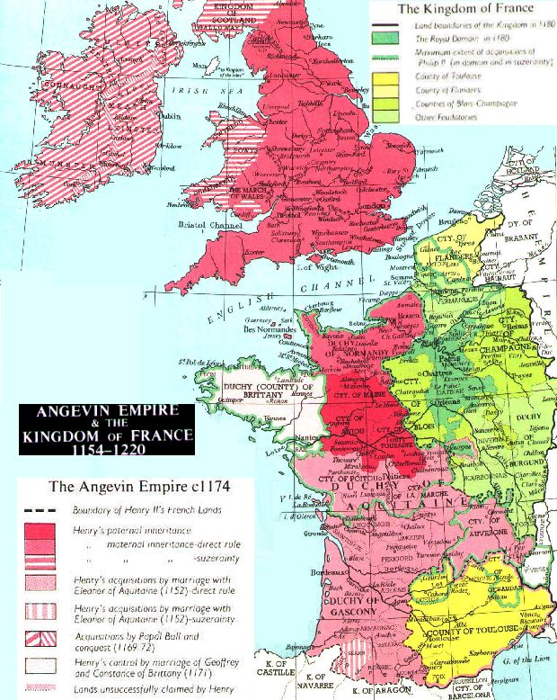
Henry II & Eleanor of Aquitaine
Or… why Marie wrote in French

Slide 15
Henry II &
Eleanor of Aquitaine
Their court was a major center of literary production in the vernacular (i.e. not Latin)
  “Historical” texts – for example:
    Verse chronicles, such as Wace’s Roman de Rou (about the dukes of Normandy) or Roman de Brut (about the kings of England)
    Romances of Antiquity, such as the Roman d’Enéas (Aeneid) or the Roman de Troie (Trojan War)
  Troubadours (singer-songwriters, 11th – 14th centuries)
    Eleanor’s grandfather was William IX of Aquitaine, the 1st named/known troubadour
    Henry & Eleanor’s second son, Richard the Lionheart, wrote troubadour songs himself

Slide 16
Initial Questions
The Literary Context: What is a “Lai”?
The Historical Context: When were they written, where, for what audience?
The Author: Who was “Marie de France”?
The Manuscript Context: Where are the Lais preserved?

Slide 17
The Manuscripts
London, British Library, Harley 978: Prologue & 12 lais
Four other manuscripts with one or more lais:
  London, BL, Cotton, Vespasian B XIV: Lanval, Ysopet
  Paris, Bibliothèque nationale de France, fr. 2168: 3 lais, Ysopet
  Paris, BnF, naf 1104: 7 lais by Marie, other anonymous lais
  Paris, BnF, fr. 24432:Yonec

Slide 18
British Library, Harley 978
Only “complete” manuscript of the Lais
  Harley 978 – digitised
This is the beginning of Marie’s Lais (folio 118r)

Slide 19
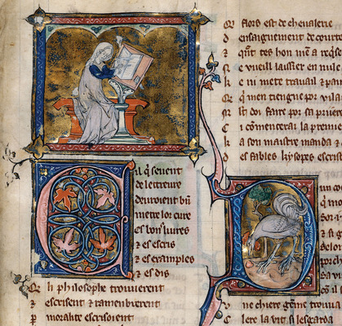
BnF, Arsenal 3142, fol. 256.
The opening of the Fables of Marie de France (Ysopet) in a fabulous late 13th c. manuscript

Slide 20
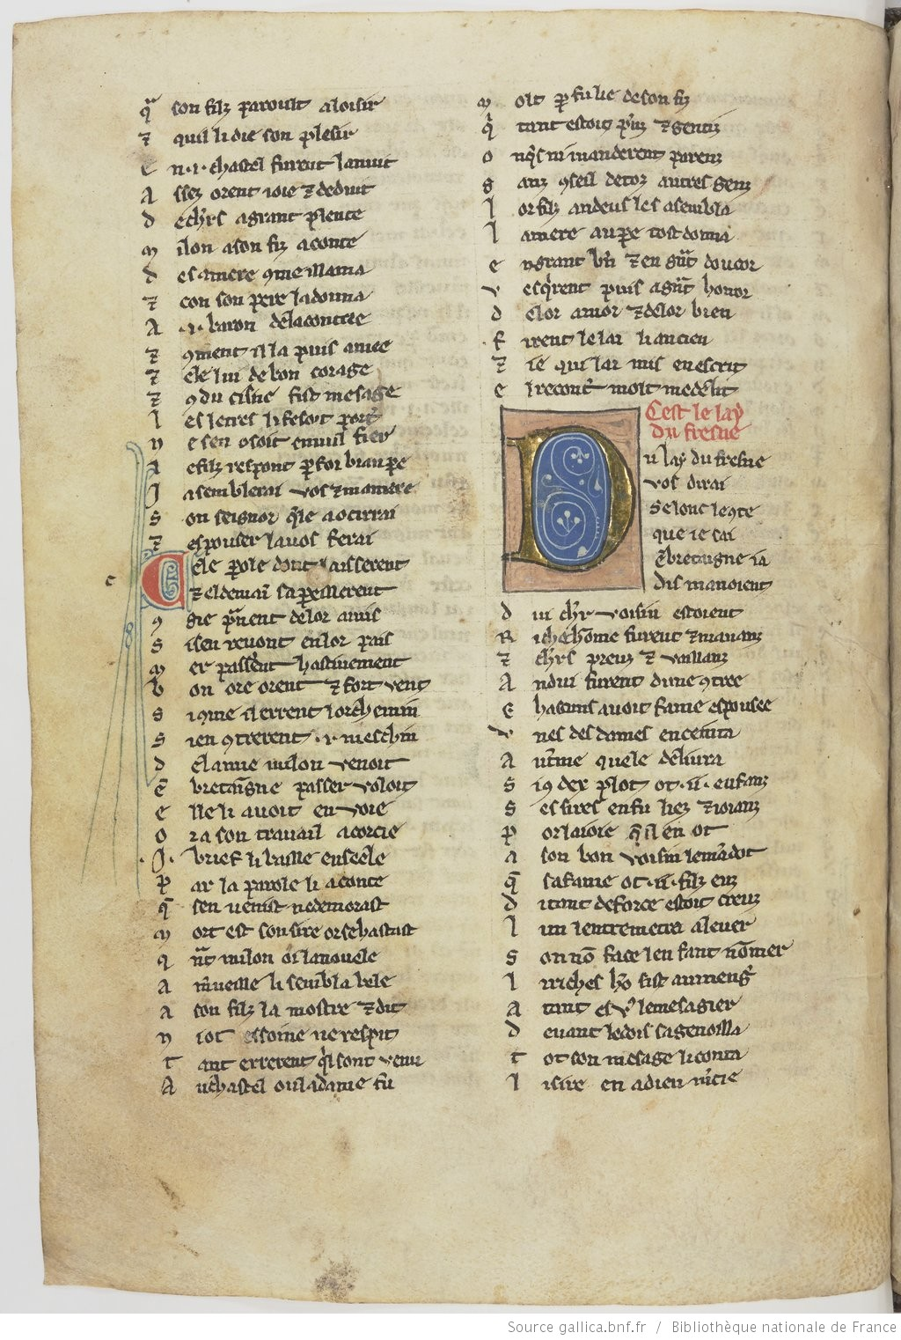
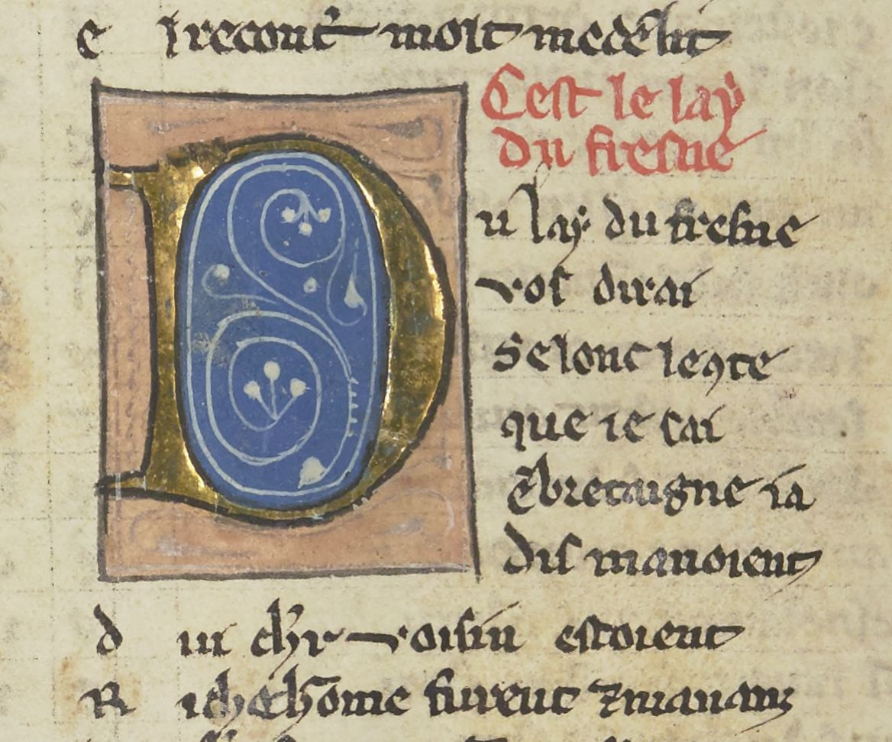
BnF, naf 1104:
Collection of lais late 13th c., Paris region
Fol. 39v

Slide 21
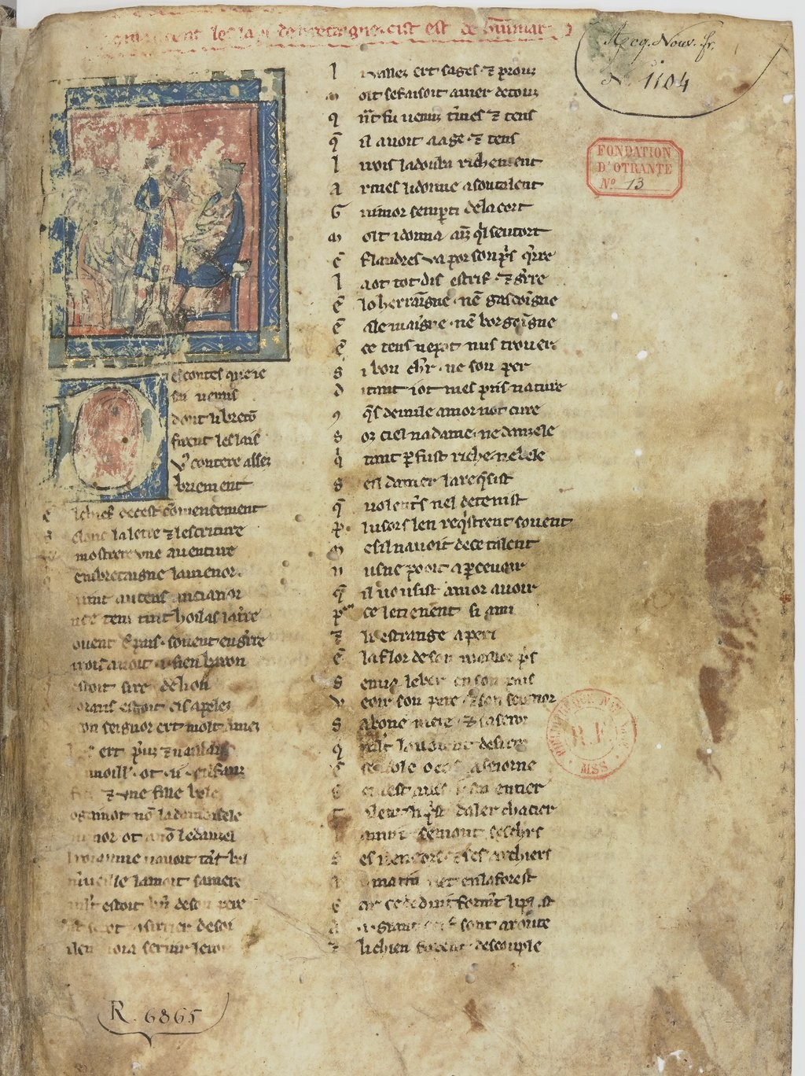
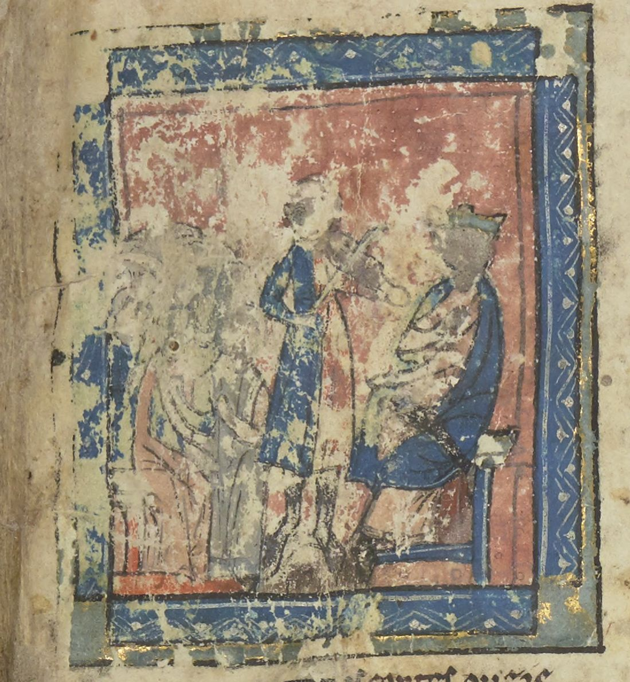
BnF, naf 1104, fol. 1
[ci] commancent les lays de bretagne. Cist est de Guigemar
[here] begin the lays of Britain/Brittany. This one is about Guigemar

Slide 22
Links to the other Manuscripts
Paris, BnF, fr. 2168
Paris, BnF fr. 24432
Paris, BnF naf 1104
(N.b. British Library, Cotton Vespasian V XIV isn’t digitized)

