Slide 1
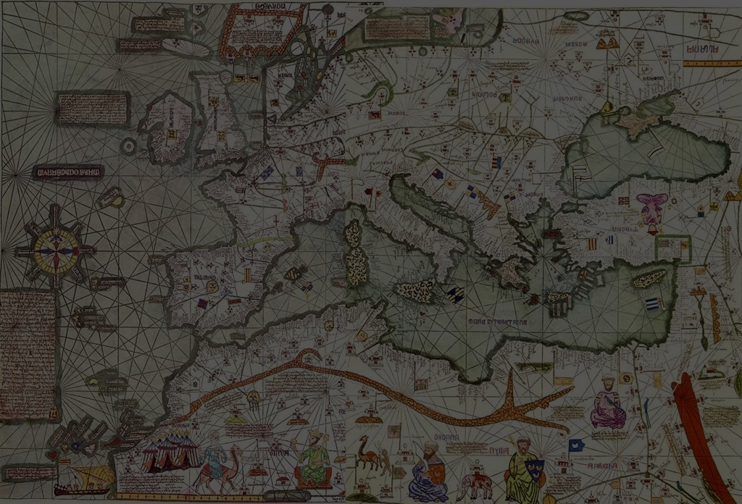
Medieval Maps and Mapping
Middle Ages for Educators
Tobias Hrynick
Dr. Helen Davies
Dr. John Wyatt Greenlee

Slide 2
Learning Outcomes
By the end of this unit, viewers will be able to:
Describe several basic types of medieval maps
Access resources for learning more about medieval maps and mapping
Notes:
Look a bit different.
Orientation is different
This layout underlines most things
Zone maps having trouble to find open source

Slide 3
Mappae Mundi and T-O Maps
Notes:
Look a bit different.
Orientation is different
This layout underlines most things
Zone maps having trouble to find open source

Slide 4
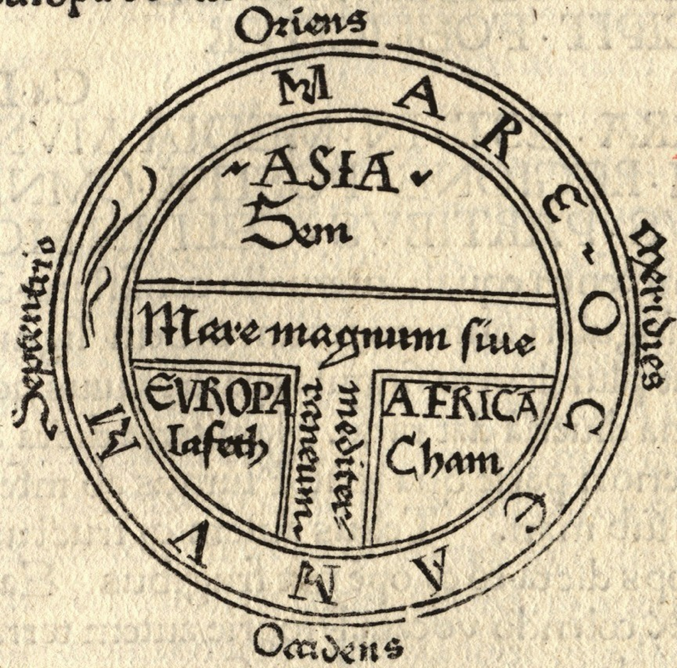
T and O Map
15th Century
Wikimedia Commons
Print, Isidore Etymologiae
Notes:
Look a bit different.
Orientation is different
This layout underlines most things
Zone maps having trouble to find open source

Slide 5
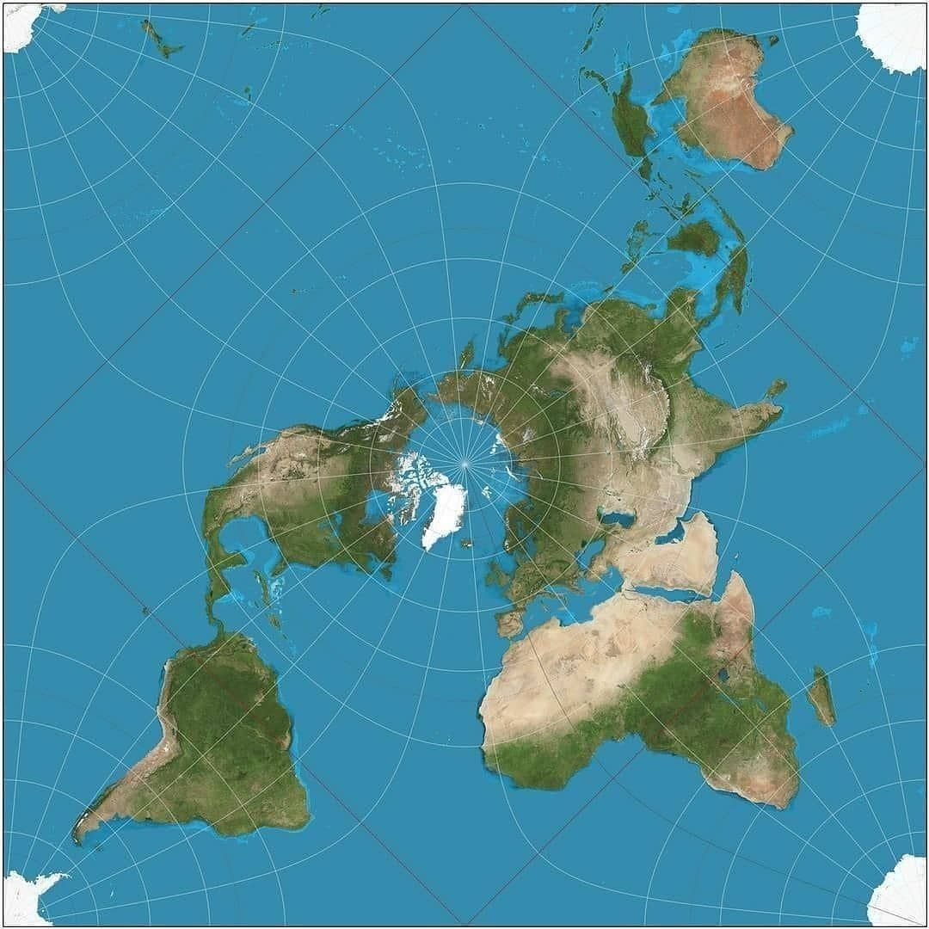

Slide 6
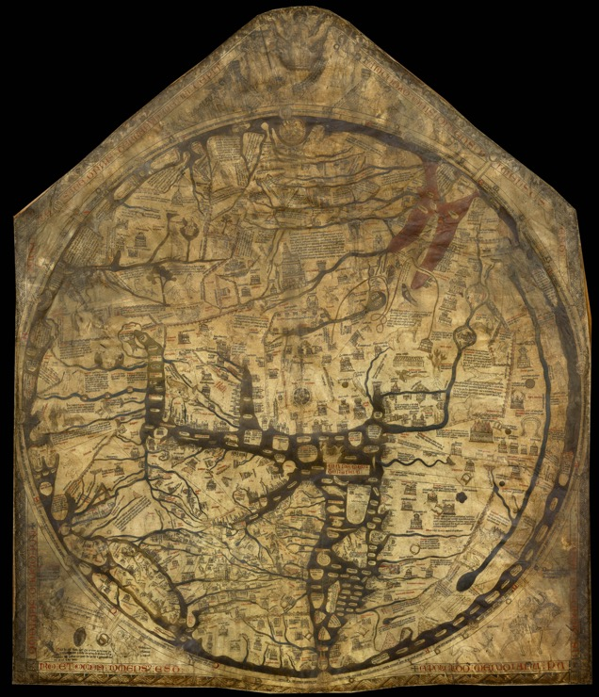
The Hereford Map
13th Century
Wikimedia commons

Slide 7
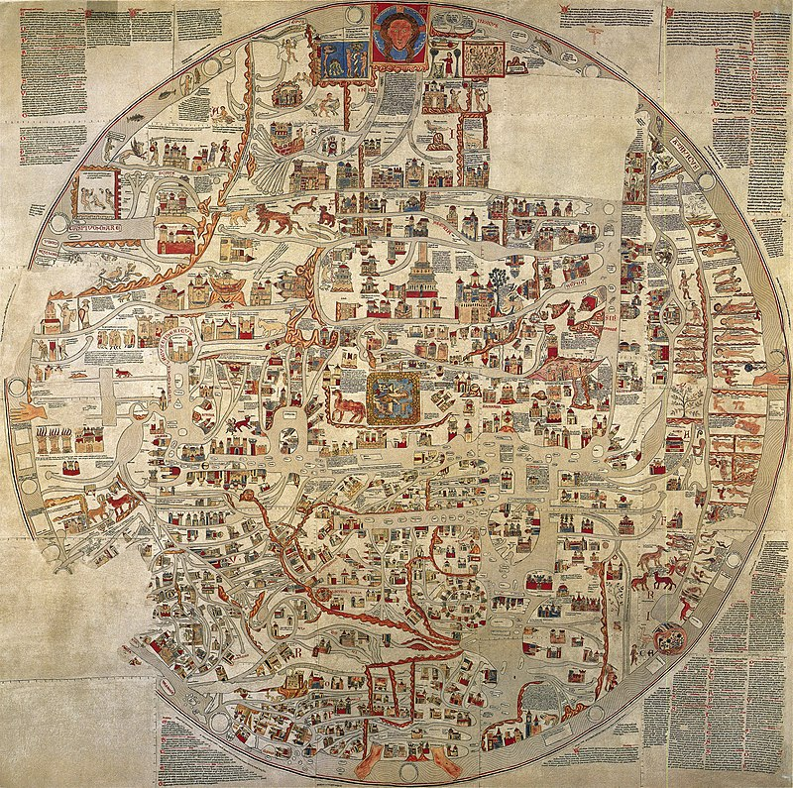
The Ebstorf Map
13th Century
Wikimedia commons

Slide 8
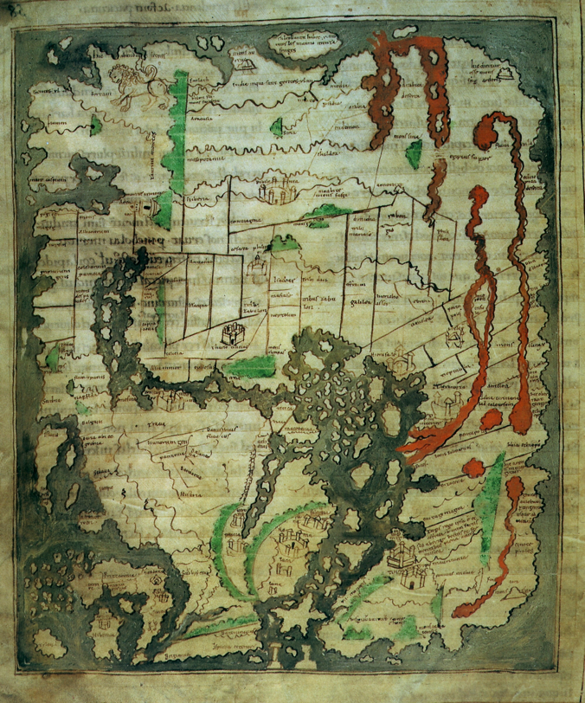
Cotton Map
11th Century
Wikimedia commons
British Library Cotton MS Tiberius BV

Slide 9
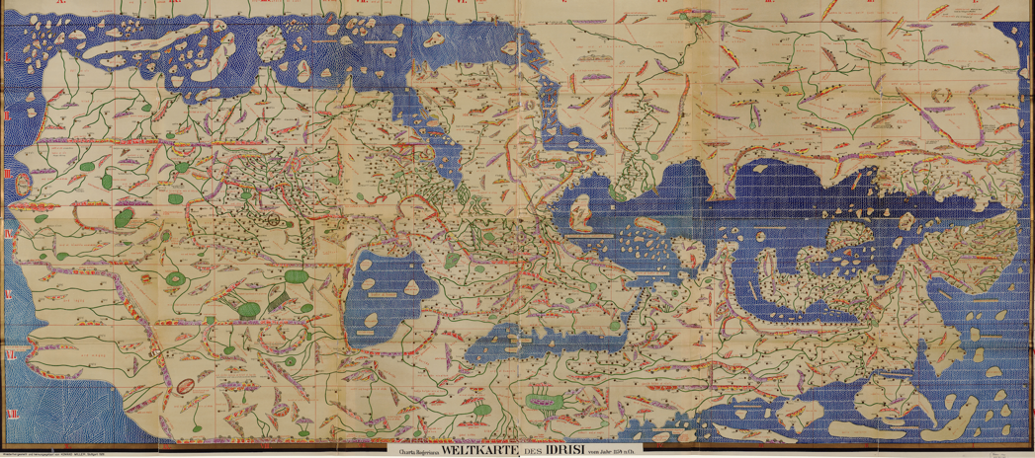
al-Idrisi Map
12th Century
Library of Congress
http://hdl.loc.gov/loc.gmd/g3200.ct001903

Slide 10
Macrobius Zonal Maps
Notes:
Look a bit different.
Orientation is different
This layout underlines most things
Zone maps having trouble to find open source

Slide 11
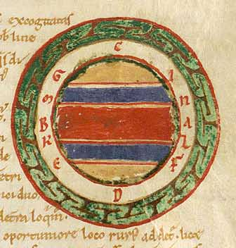
12th Century
Copenhagen, Det Kongelige Bibliotek, ms. NKS 218 4°, fol. 34r

Slide 12
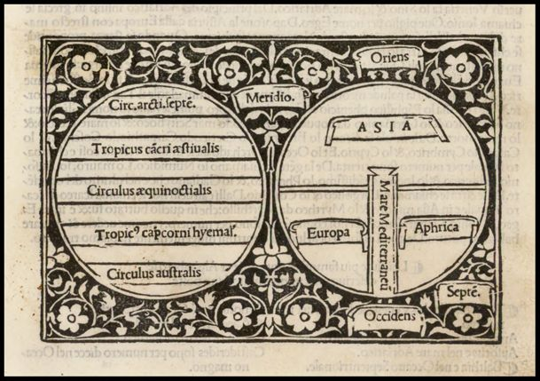
Macrobius map and Mappamundi
1503
Barry Lawrence Ruderman Map Collection

Slide 13
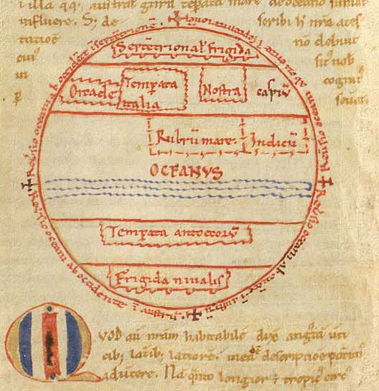
Macrobius zonal map with geography noted
12th Century
Copenhagen, Det Kongelige Bibliotek, ms. NKS 218 4°

Slide 14
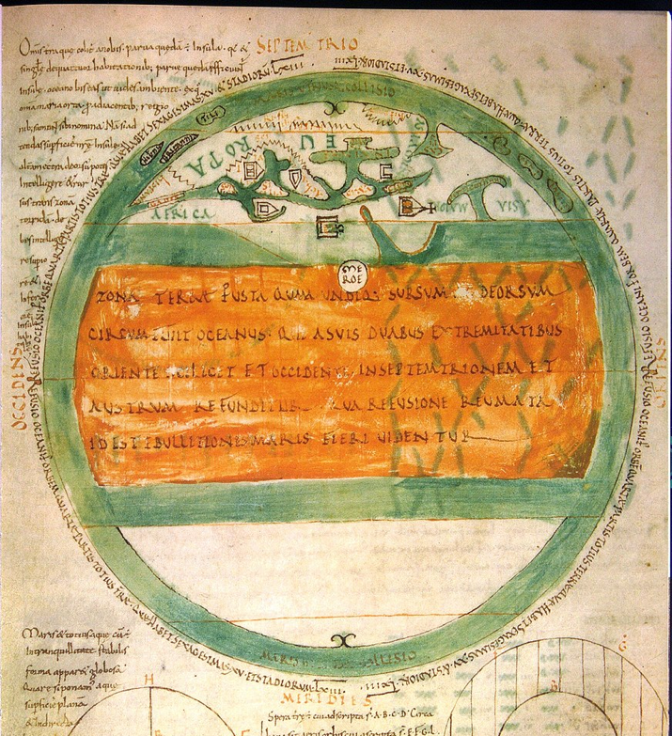
Abbo of Fleury’s
map of the world
10th Century
Berlin, Staatsbibliothek, Ms. Phill. 1833, fol. 39v.
Notes:
Abbo of Fleury’s map of the world

Slide 15
Portolan Charts
Notes:
Look a bit different.
Orientation is different
This layout underlines most things
Zone maps having trouble to find open source

Slide 16
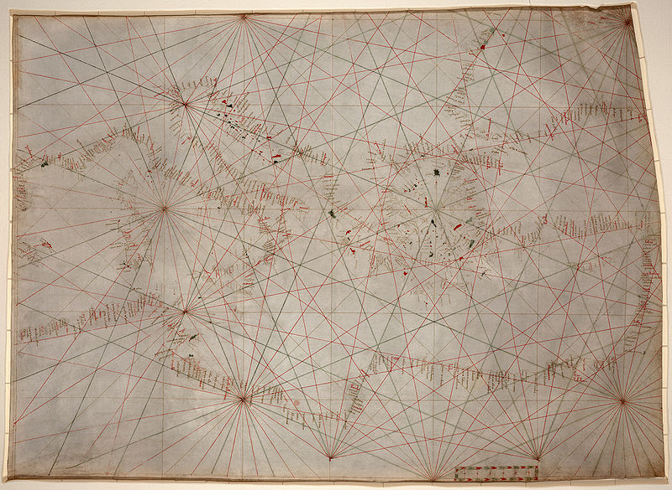
Mediterranean Portolan Chart
14th Century
Library of Congress G5672.M4P5 13-- .P6

Slide 17
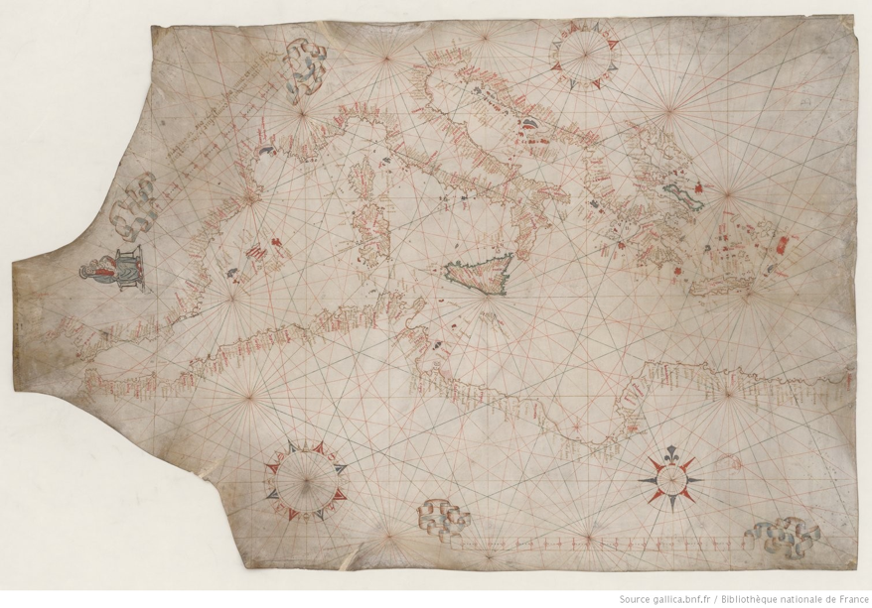
Mediterranean Portolan Chart
16th Century
Bibliothèque nationale de France, département Cartes et plans, GE C-5084

Slide 18
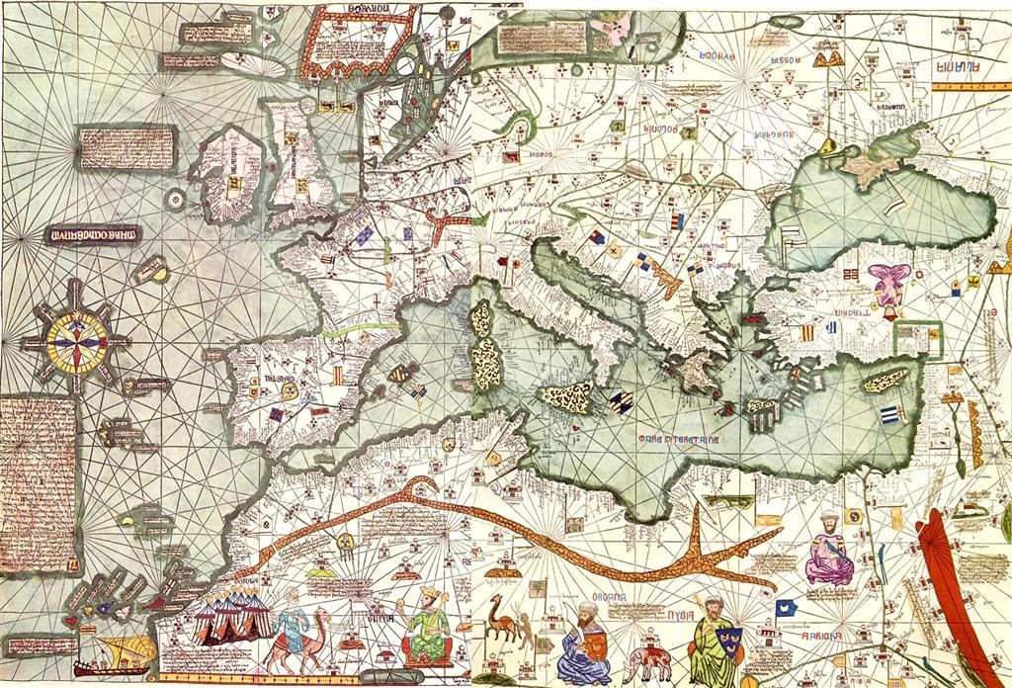
Catalan Atlas
14th Century
Wikipedia Commons
https://en.wikipedia.org/wiki/File:Europe_Mediterranean_Catalan_Atlas.jpeg

Slide 19
Other Kinds of Medieval Maps
Notes:
Look a bit different.
Orientation is different
This layout underlines most things
Zone maps having trouble to find open source

Slide 20
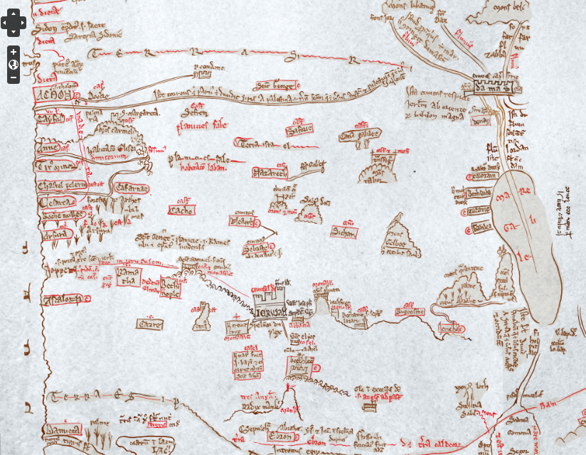
Fordham Center for Medieval Studies Oxford Outremer Map Project
https://medievaldigital.ace.fordham.edu/mapping-projects/oxford-outremer-map-project/

Slide 21
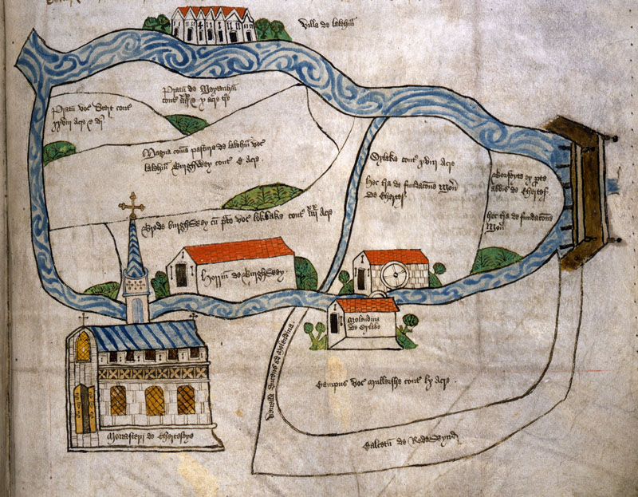
Chertsey Abbey, Surrey
15th Century
British National Archives E164/25

Slide 22
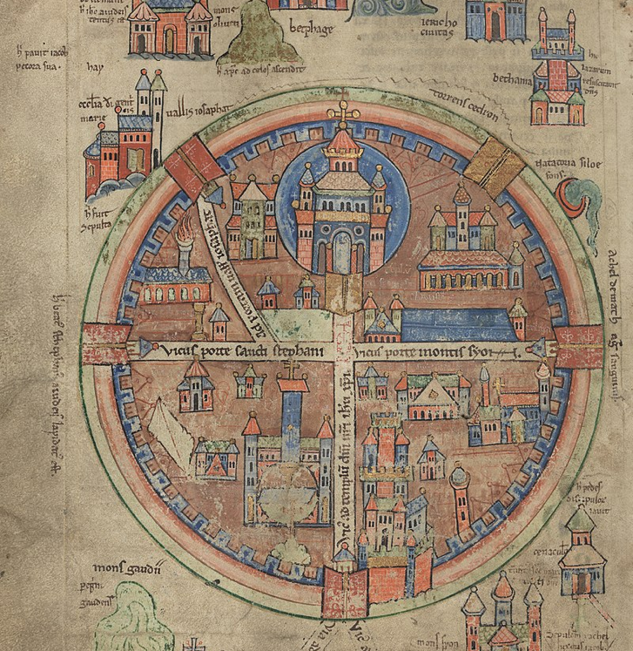
Upsala map of Jerusalem
13th Century
Uppsala University Library, MS C 691, fol 39

Slide 23
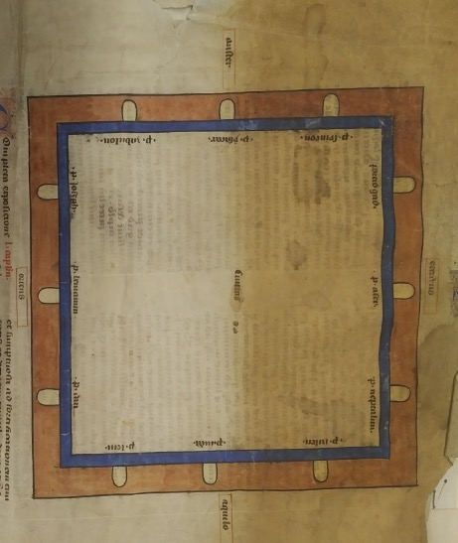
Plan of the Jerusalem of Revelations from Gloss of Nicholas of Lyra
New York, Fordham University, Walsh Library, Archives and Special Collections, MS Item 23
Image Courtesy of Courtesy of Fordham University Library, Bronx NY

Slide 24
Further Resources
Notes:
Look a bit different.
Orientation is different
This layout underlines most things
Zone maps having trouble to find open source

Slide 25
Medieval Maps and Mapping Resources Site
https://historiacartarum.org/medieval-maps-and-mapping-resources/
Mapping Mandeville Project
https://historiacartarum.org/john-mandeville-and-the-hereford-map-2/
Matthew Paris’s Clickable Map of England
https://historiacartarum.org/annotated-claudius-map/
Fordham Center for Medieval Studies Oxford Outremer Project
https://medievaldigital.ace.fordham.edu/mapping-projects/oxford-outremer-map-project/

Slide 26
Gough Map Project
http://www.goughmap.org/
Digita Mappa
https://www.digitalmappa.org/
Pelagios
https://pelagios.org/
Recogito
https://recogito.pelagios.org/

